Slide 1

Week04 - Data in UIKit
In the AI Era(Swift + SwiftUI)
Instructor : Mr. Nem Sothea
nemsothea13@gmail.com

Slide 2
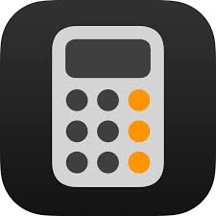
2. 📋 Today's Journey
⌛ Data Models
• Understanding model objects
• Creating TodoItem struct
• Building TodoList manager
⌛ User Interface
• UITableView fundamentals
• Custom UITableViewCell
• Connecting data to views
⌛ Architecture
• MVC pattern deep dive
• Refactoring for clean code
• Best practices review

Slide 3
3. 📱🎯 Our Goal: To-Do List App
✅ Display list of tasks
✅ Add new tasks
✅ Mark tasks complete/incomplete
✅ Delete tasks
✅ Persistent storage
📱 Simple but powerful iOS app!

Slide 4
4. Understanding Models
🤔 What are Model Objects?
MODELS = DATA + BUSINESS LOGIC
• Represent your app's data
• Define the structure of information
• Contain business rules and logic
• Independent of UI
• Reusable across different views
Example: User, Posts, Product, Order, TodoItem

Slide 5
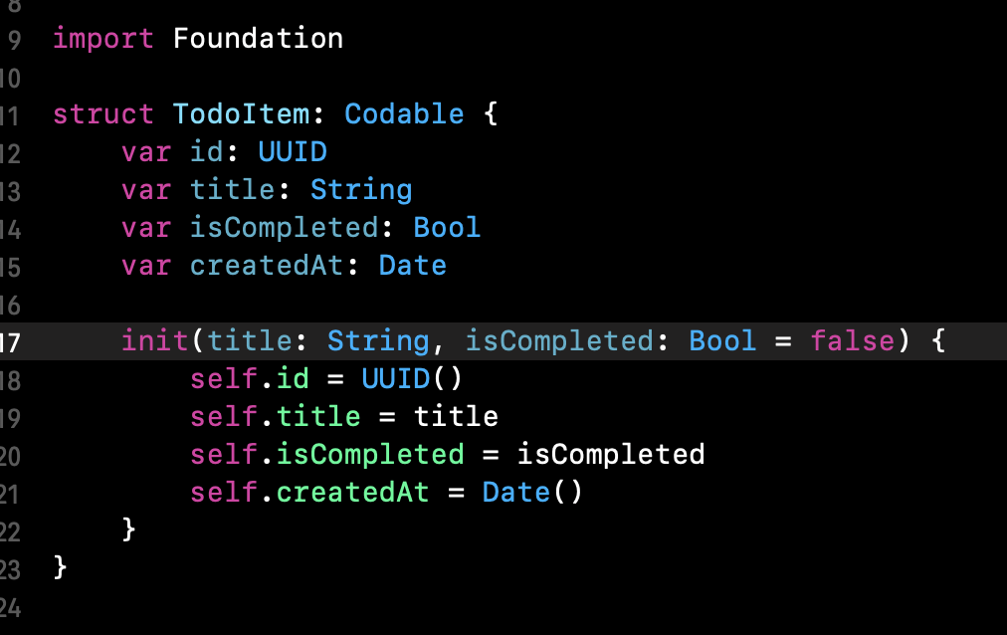
5. Why Use Structs for Models?
🏗️ Choosing Value Types: Structs
✅ Value semantics - copied, not shared
✅ Thread-safe by default
✅ Predictable behavior
✅ Easy to reason about
✅ Swift's preferred approach

Slide 6
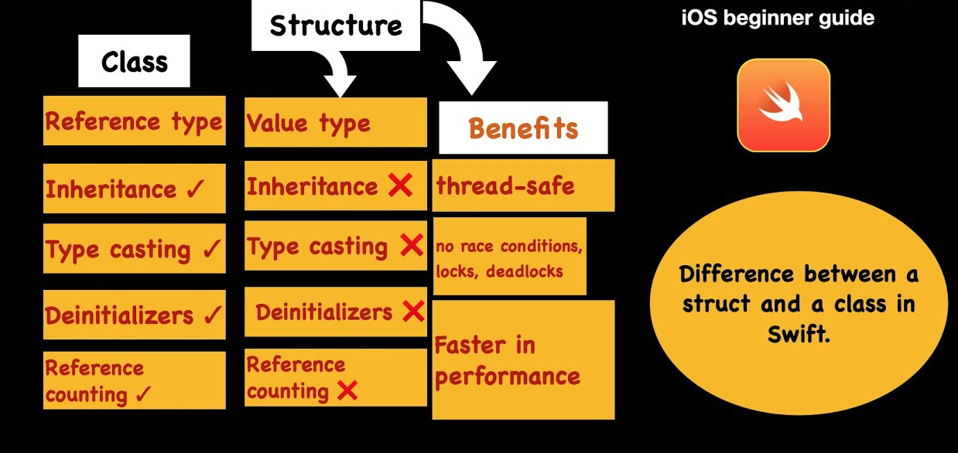
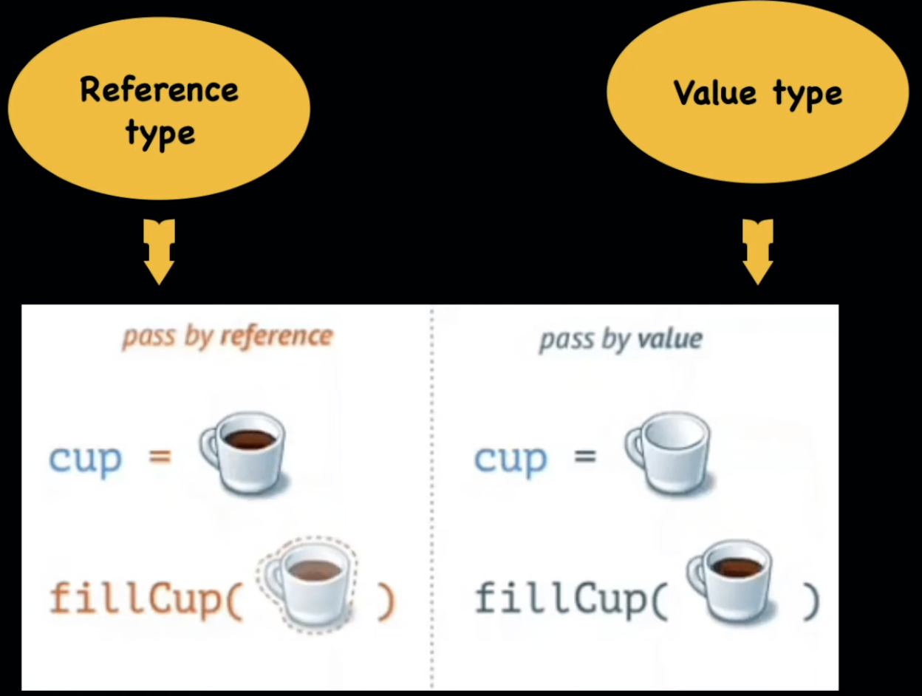
Structs Vs Class?

Slide 7
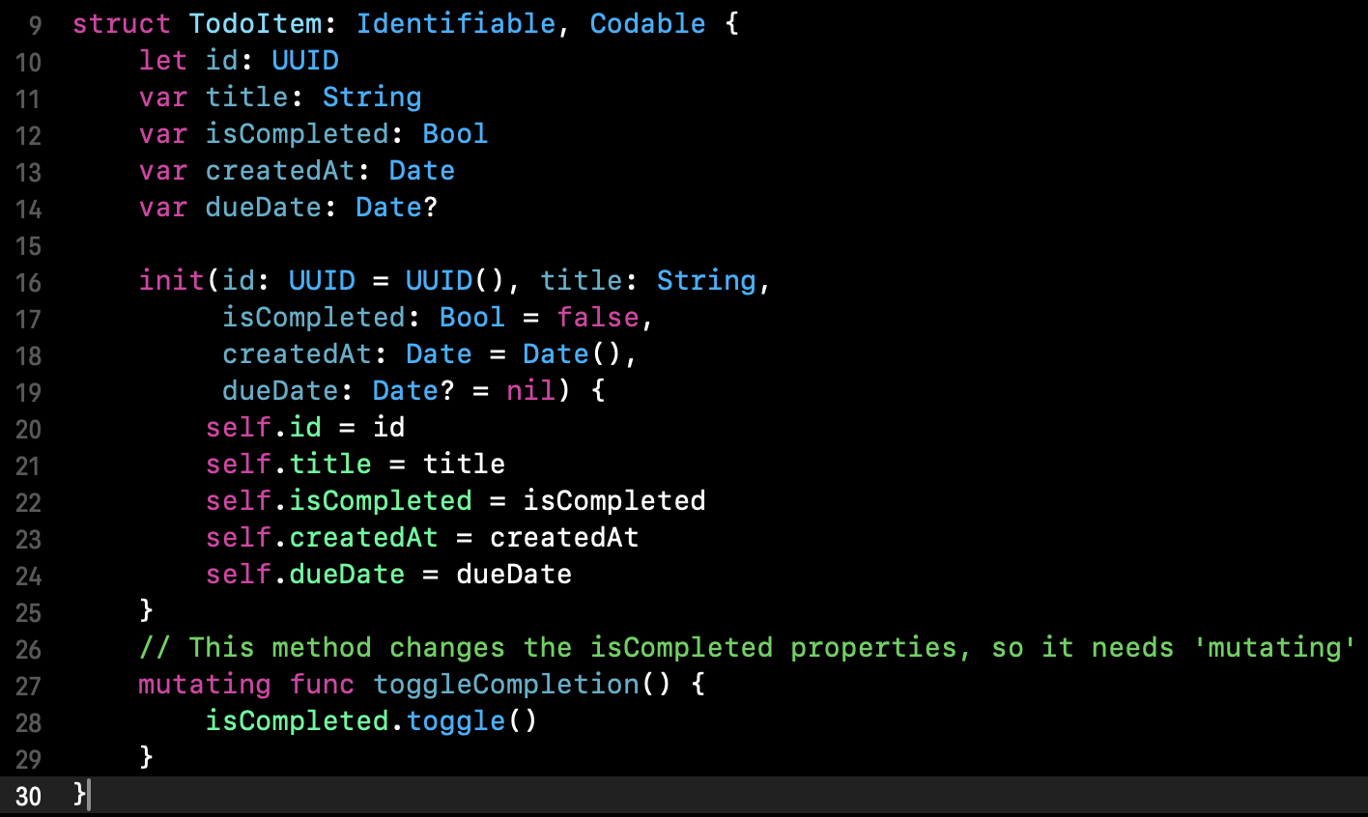
6. Creating TodoItem Model

Slide 8
6. Creating TodoItem Model

Slide 9
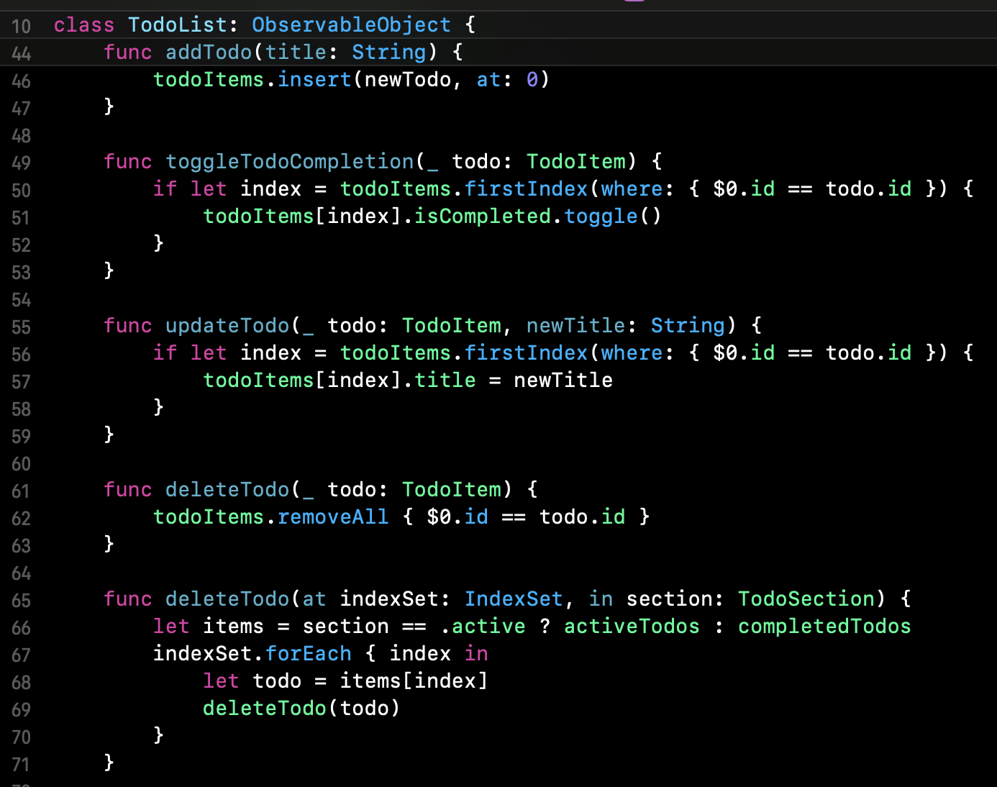
7. TodoList Manager Class
CRUD operations (Create, Read, Update, Delete)
Data persistence
Business logic enforcement

Slide 10
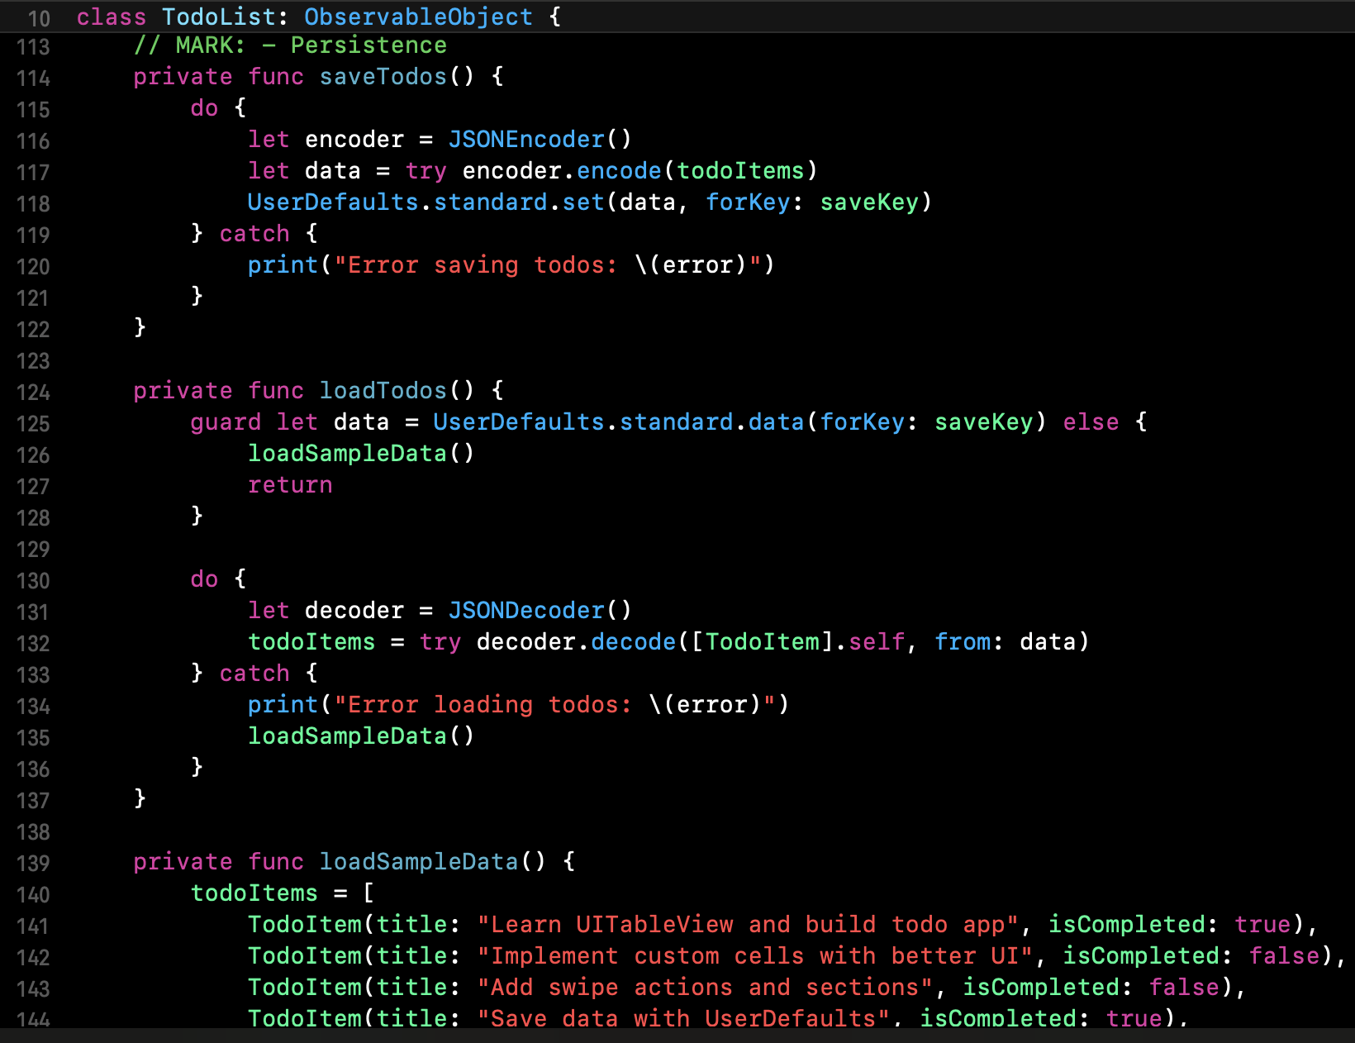
8. Data Persistence
Why UserDefaults?
Simple key-value storage
Good for small data sets
Easy to implement
Great for learning

Slide 11
9. Introduction to UITableView
📊 UITableView Fundamentals
• Most common iOS UI component
• Displays scrollable lists
• Reuses cells for memory efficiency
• Requires two protocols:
- UITableViewDataSource
- UITableViewDelegate
┌─────────────────────┐
│ ▢ Buy milk │ ← UITableViewCell
│ ▢ Learn UIKit │ ← UITableViewCell
│ ▢ Build awesome app │ ← UITableViewCell
└─────────────────────┘

Slide 12
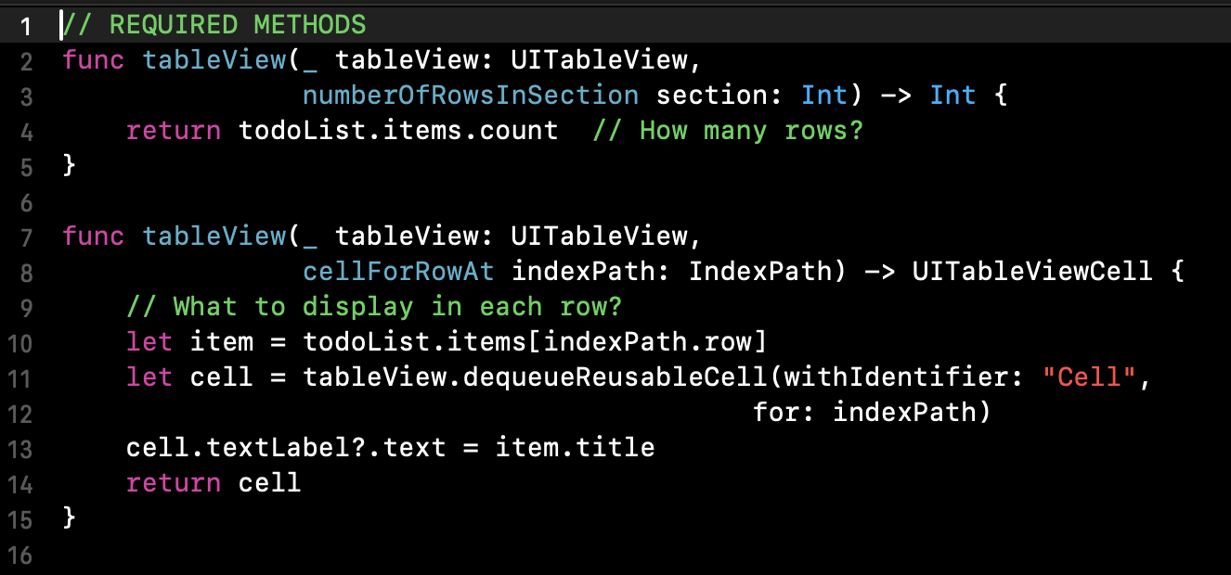
10. UITableViewDataSource
numberOfRowsInSection: Tell table how many items
cellForRowAt: Configure each cell
indexPath: Which row and section
Cell reuse for performance

Slide 13
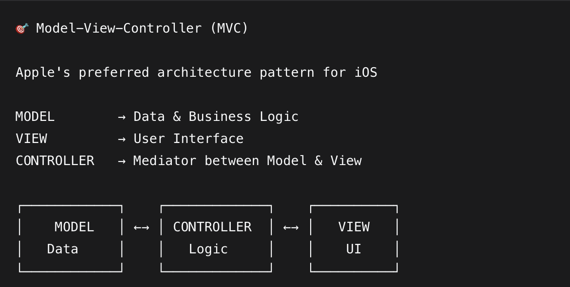
11. What is MVC?

Slide 14
12. MVC in Our App
🏗️ Our To-Do App Architecture
MODEL:
• TodoItem struct
• TodoList class
VIEW:
• TodoItemCell
• UITableView
• UIButton, UILabel
CONTROLLER:
• TodoListViewController
• Handles user input
• Updates model
• Refreshes views

Slide 15
13. Data Flow in MVC
🔄 How Data Flows
1. USER ACTION → "Tap Add Button"
2. VIEW → Notifies CONTROLLER
3. CONTROLLER → Updates MODEL ("Add new item")
4. MODEL → Notifies CONTROLLER ("Data changed")
5. CONTROLLER → Updates VIEW ("Reload table")
✅ Separation of Concerns
✅ Testable Components
✅ Maintainable Code

Slide 16
14. Benefits of MVC
🌟 Why Use MVC?
🎯 SEPARATION OF CONCERNS
• Models don't know about UI
• Views are dumb display components
• Controllers handle coordination
🔄 REUSABILITY
• Use same models across different views
• Reuse views with different data
🏗️ MAINTAINABILITY
• Easy to modify one component
• Clear responsibilities

Slide 17
15. Common MVC Mistakes
⚠️ problem to Avoid
🚫 MASSIVE VIEW CONTROLLER
• Putting too much logic in controllers
• Solution: Extract to model or helper classes
🚫 TIGHT COUPLING
• Models referencing views
• Views knowing about controllers
• Solution: Use protocols and delegation
🚫 BUSINESS LOGIC IN VIEWS
• Views making data decisions
• Solution: Keep views dumb, controllers smart

Slide 18
16. Recap & Key Takeaways
🎓 What We Learned Today
✅ MODELS: Structs for data, classes for managers
✅ VIEWS: UITableView, custom cells, reusable components
✅ CONTROLLERS: Mediate between models and views
✅ MVC: Clear separation of concerns
✅ PERSISTENCE: UserDefaults for simple data

Slide 19
Homework
*Refactor existing project to MVC with good practise structure folder, class,Model, ect.
**Research about MVVM pattern is plus.

Slide 20
Questions?
Next Week: Hello, SwiftUI! The Paradigm Shift~
Thank you!

